Slide 1
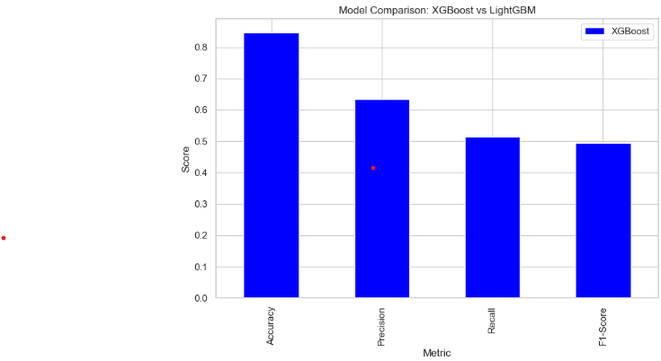
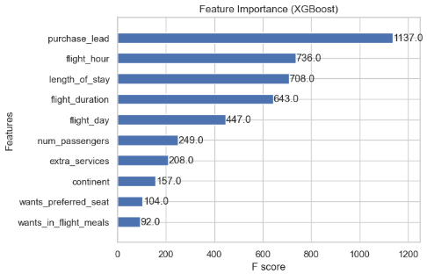
Model Evaluation
ROC Curve Graph
Feature Importance

